Slide 1



Inferring Information Flow in Neural Circuits Formal Definition and Neuroengineering
Praveen Venkatesh
Dept. of Electrical & Computer Engineering Carnegie Mellon University
“Information Flow in Computational Systems” arXiv:1902.02292 [cs.IT] (under review)
(https://praveenv253.github.io/publications)

Slide 2
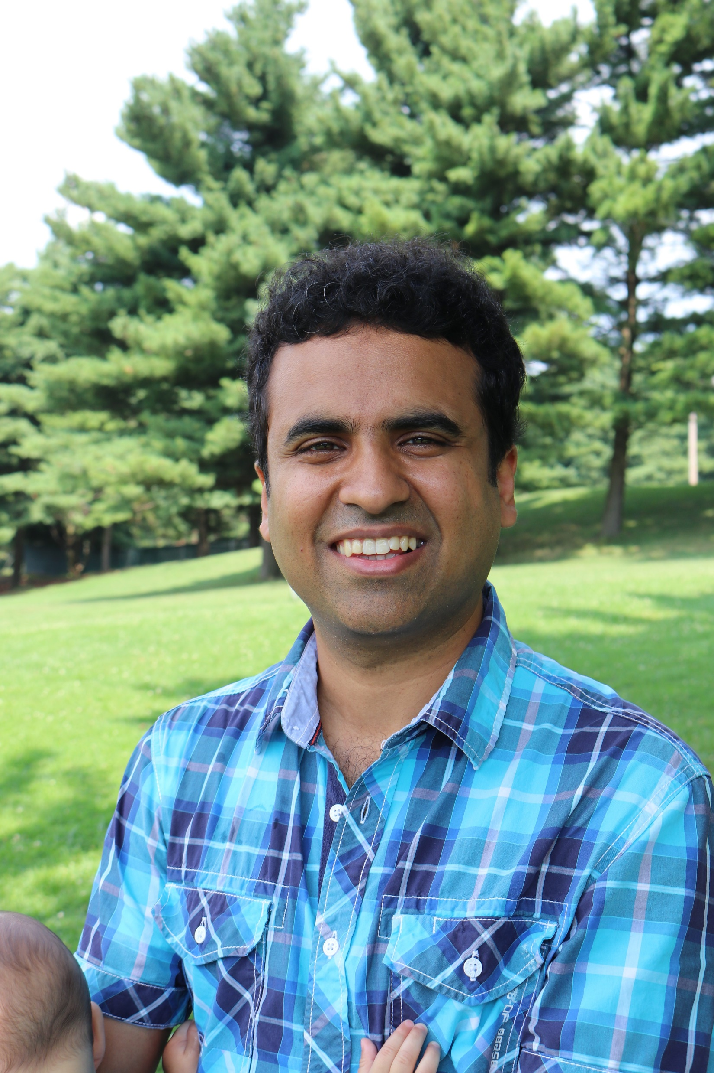











Acknowledgments
Advisor
Neuroscientists
Clinicians
Theorists
Pulkit Grover (CMU)
Marlene Behrmann (CMU)
Rob Kass (CMU)
Mark Richardson (MGH/Harvard)
Vasily Kokkinos (MGH/Hvd)
Todd Coleman (UCSD)
Bobak Nazer (BU)
Venkatesh Saligrama (BU)
Labmates & Colleagues
Fellowships
CMLH Fellowship in Digital Health
Dowd Fellowship
Henry L. Hillman Presidential Fellowship
CIT Dean’s Fellowship
Sanghamitra Dutta (CMU)
Aditya Gangrade (BU)
Ashwati Krishnan (CMU)
Alireza
Chamanzar
(CMU)
Haewon Jeong (CMU)

Slide 3
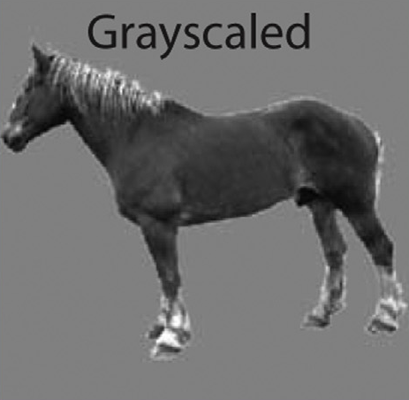
A Typical Neuroscientific Experiment
Region C
Region B
Info “flows” between brain regions
Info is often about a stimulus
There could be feedback
Region A
(Almeida et al., Cortex, 2013)
“Stimulus”
Goal: Find a definition for information flow, so that we can track info paths

Slide 4
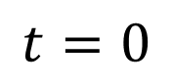

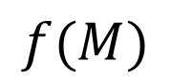
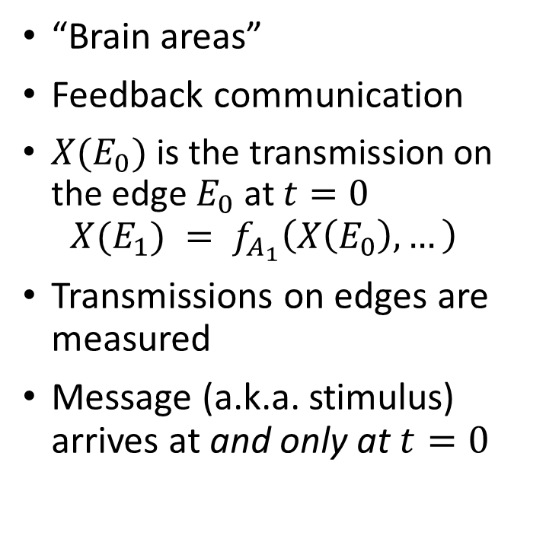

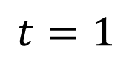

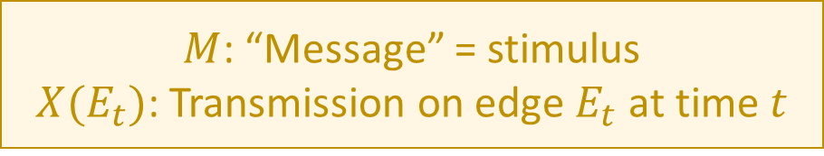
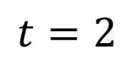
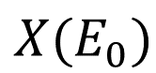
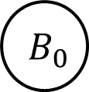


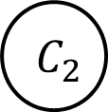

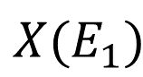

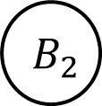
A Computational Model of the Brain
“Brain areas”
Feedback communication
$X(E_{0})$ is the transmission on the edge $E_{0}$at $t=0$ $X(E_{1}) = f_{A_{1}}\left(X\left(E_{0}\right), …\right)$
Transmissions on edges are measured
Message (a.k.a. stimulus) arrives at and only at $t=0$
$$t=0$$
$$t=1$$
$$t=2$$
$$M$$
$$A_{0}$$
$$X(E_{0})$$
$$A_{1}$$
$$X(E_{1})$$
$$A_{2}$$
Region C
Region B
$$B_{0}$$
$$B_{1}$$
$$B_{2}$$
Region A
$$C_{0}$$
$$C_{1}$$
$$C_{2}$$
$$f(M)$$
(Thompson, 1980: VLSI) (Ahlswede et al., 2000: Network Info Theory) (Peters et al., 2016: Causality)
Stimulus
$M$: “Message” = stimulus
$X(E_{t})$: Transmission on edge $E_{t}$ at time $t$

Slide 5


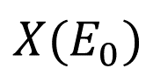
A Computational Model of the Brain
“Brain areas”
Feedback communication
$X(E_{0})$ is the transmission on the edge $E_{0}$at $t=0$ $X(E_{1}) = f_{A_{1}}\left(X\left(E_{0}\right), …\right)$
Transmissions on edges are measured
Message (a.k.a. stimulus) arrives at and only at $t=0$
$$t=0$$
$$t=1$$
$$t=2$$
$$M$$
$$A_{0}$$
$$X(E_{0})$$
$$A_{1}$$
$$X(E_{1})$$
$$A_{2}$$
$$B_{0}$$
$$B_{1}$$
$$B_{2}$$
$$C_{0}$$
$$C_{1}$$
$$C_{2}$$
$$f(M)$$
(Thompson, 1980: VLSI) (Ahlswede et al., 2000: Network Info Theory) (Peters et al., 2016: Causality)
Goal: Define info flow + track info path

Slide 6
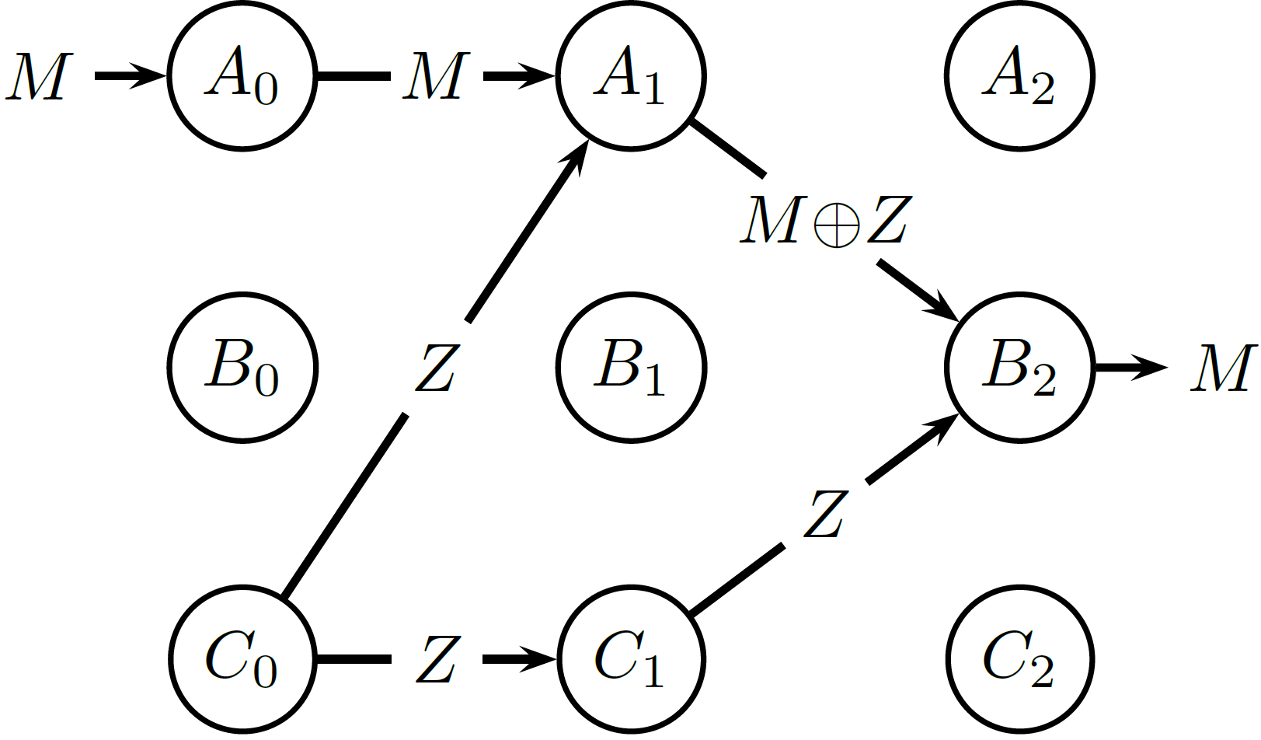
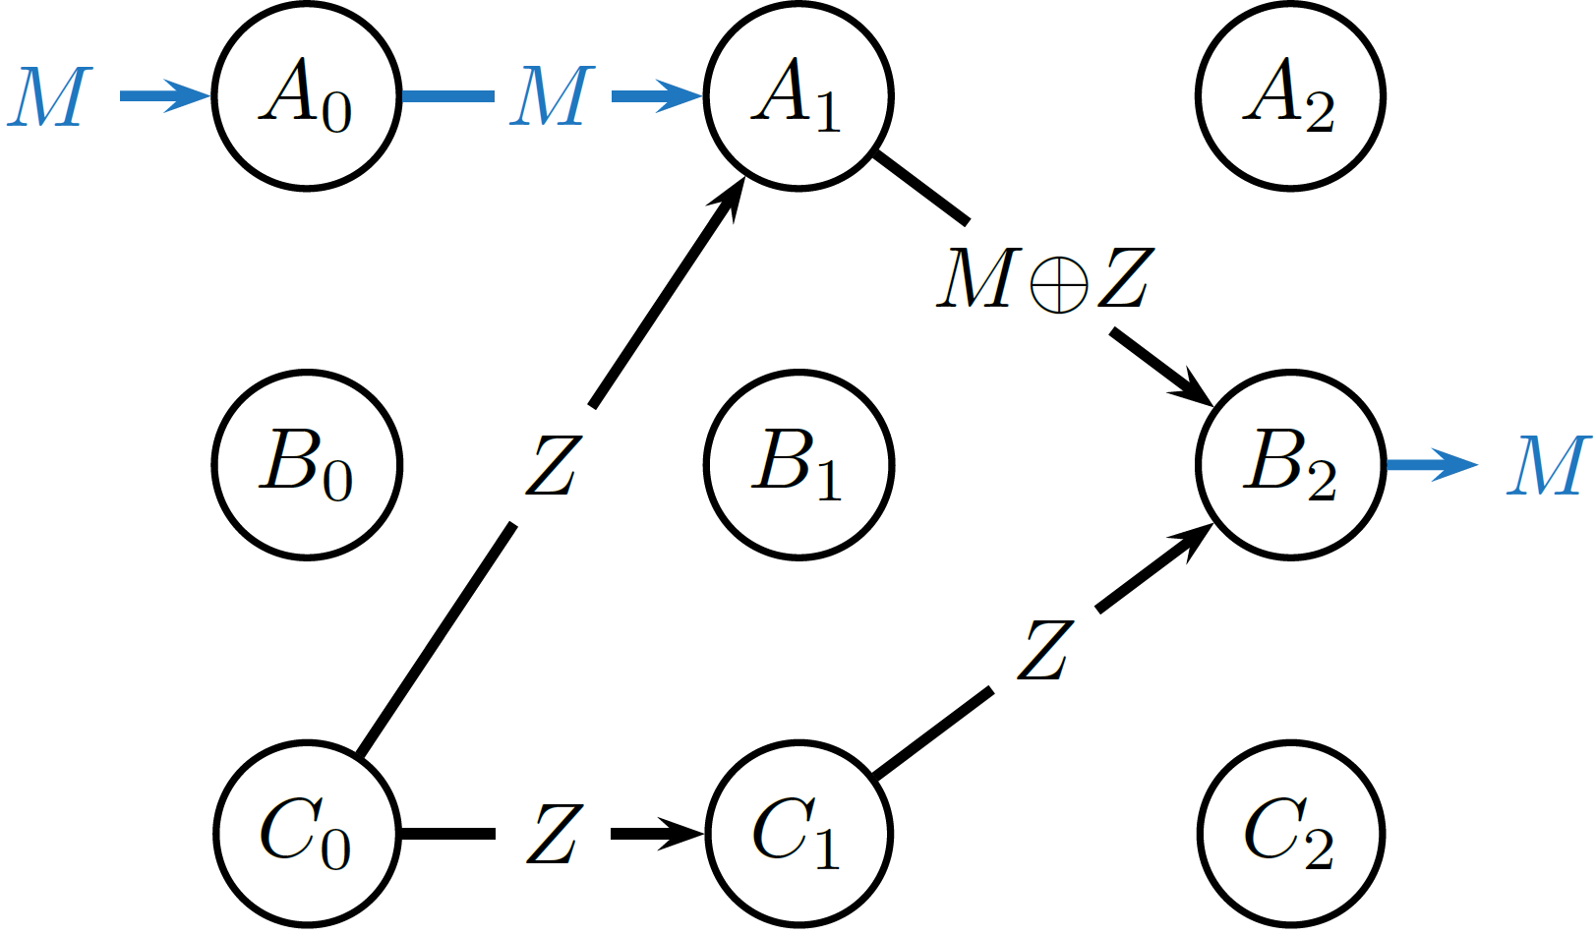
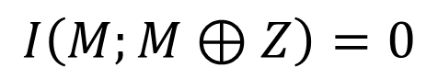
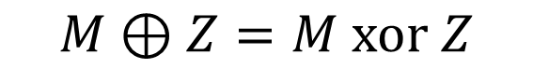
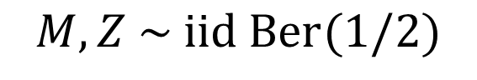

How do we define Information Flow?
1
2
3
Candidate definition 1: Dependence
Information flows on an edge $E_{t}$ if $I\left(M;X\left(E_{t}\right)\right)>0.$
✓
$$M, Z \sim iid Ber(1/2)$$
$$M⊕Z=M xor Z$$
$$I\left(M;M⊕Z\right)=0$$

Slide 7
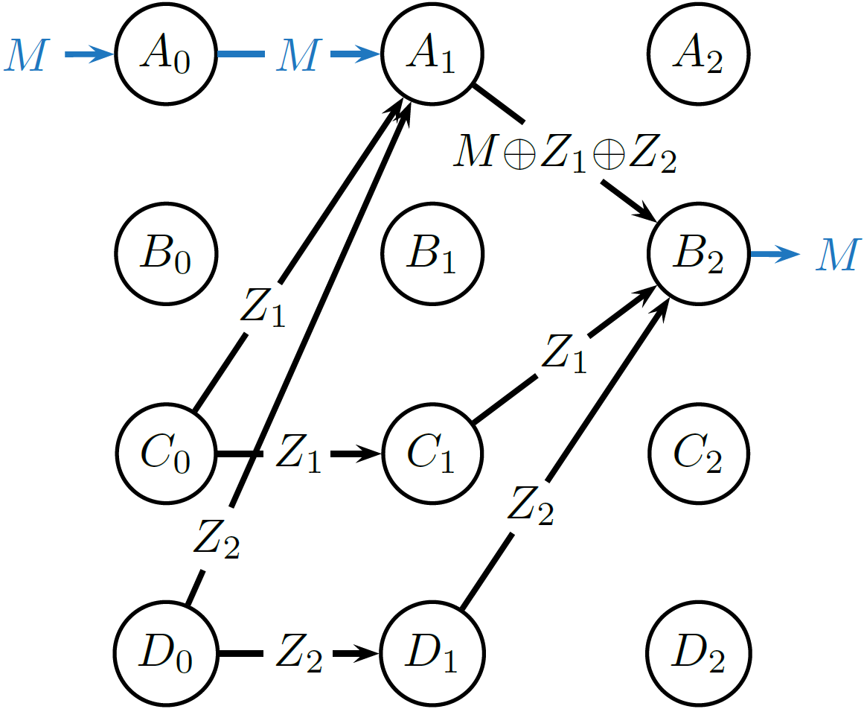
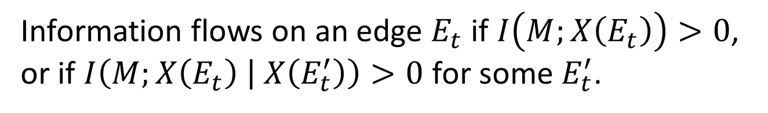
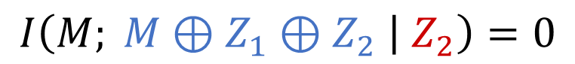
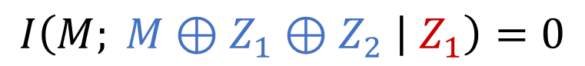
How do we define information flow?
1
2
Candidate definition 2: Condition on one edge
3
Information flows on an edge $E_{t}$ if $I\left(M;X\left(E_{t}\right)\right)>0$, or if $I\left(M;X\left(E_{t}\right) | X\left(E_{t}^{′}\right)\right)>0$ for some $E_{t}^{′}$.
✓
$$I\left(M; M⊕Z_{1}⊕Z_{2} | Z_{1}\right)=0$$
$$I\left(M; M⊕Z_{1}⊕Z_{2} | Z_{2}\right)=0$$

Slide 8
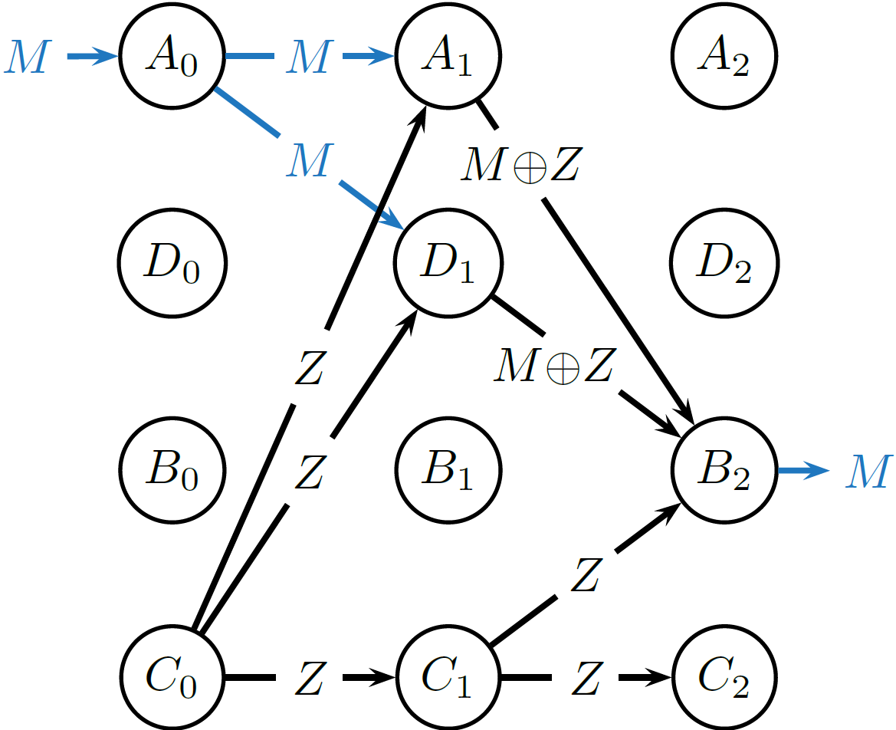
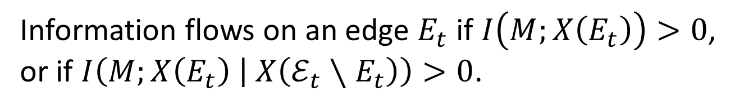
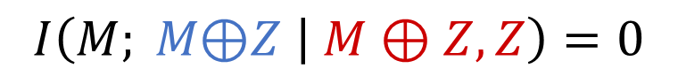
How do we define information flow?
1
2
Candidate definition 3: Condition on all other edges
3
Information flows on an edge $E_{t}$ if $I\left(M;X\left(E_{t}\right)\right)>0$, or if $I\left(M;X\left(E_{t}\right) | X\left(ℰ_{t}∖E_{t}\right)\right)>0$.
✓
$$I\left(M; M\text{⊕}Z | M⊕Z, Z\right)=0$$

Slide 9
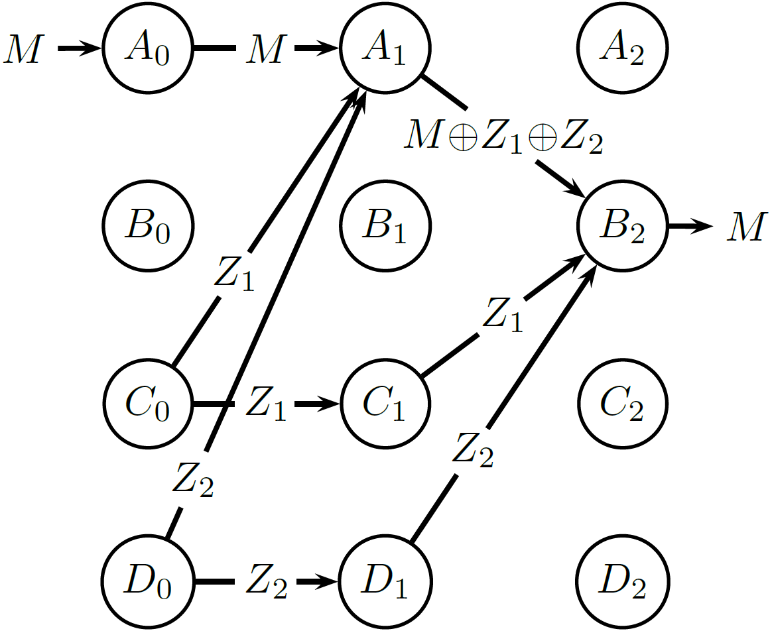
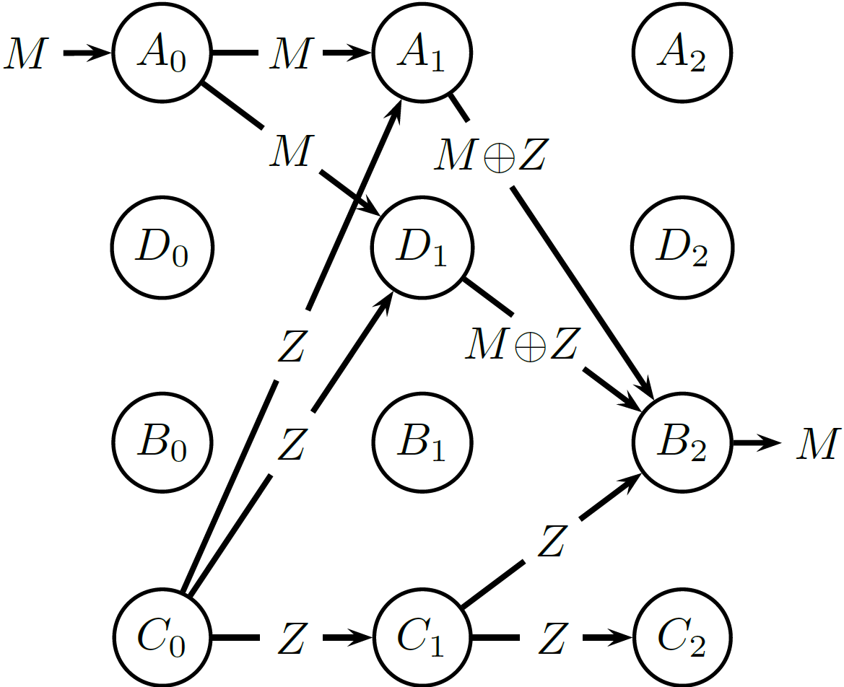
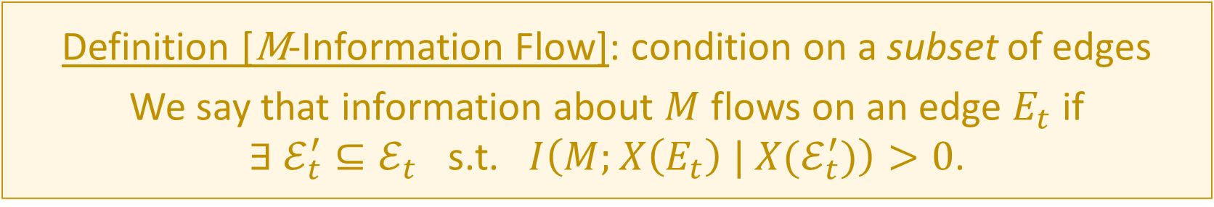
How do we define information flow?
1
2
Definition [M-Information Flow]: condition on a subset of edges
We say that information about $M$ flows on an edge $E_{t}$ if
$∃ ℰ_{t}^{′}⊆ℰ_{t}$ s.t. $I\left(M;X\left(E_{t}\right) | X(ℰ_{t}^{′})\right)>0$.
3
✓

Slide 10
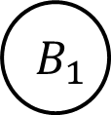

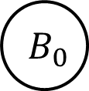
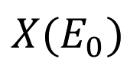
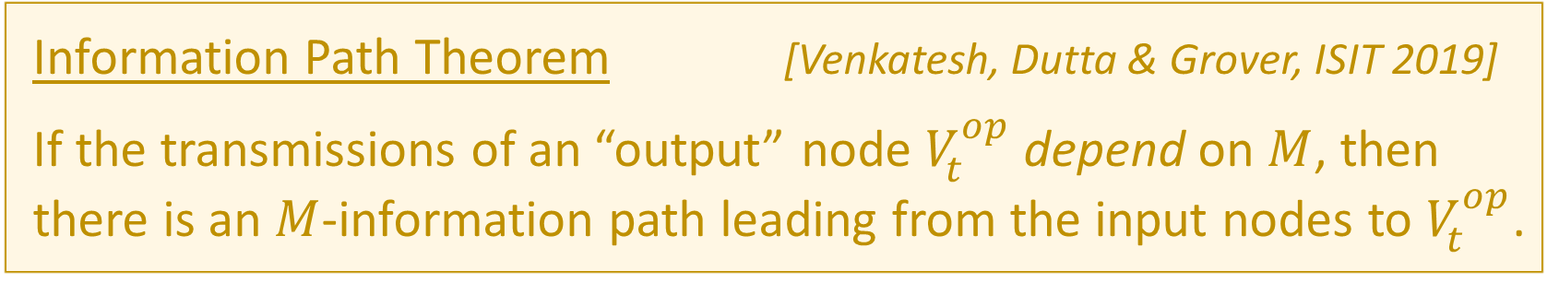

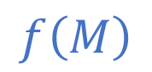




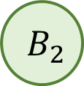
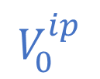
The Existence of Information Paths
$$V_{0}^{ip}$$
$$M$$
$$A_{0}$$
$$X(E_{0})$$
$$A_{1}$$
$$X(E_{1})$$
$$A_{2}$$
$$V_{t}^{op}$$
$$B_{0}$$
$$B_{1}$$
$$B_{2}$$
$$f\left(M\right)$$
Information Path Theorem [Venkatesh, Dutta & Grover, ISIT 2019]
If the transmissions of an “output” node $V_{t}^{op}$ depend on $M$, then there is an $M$-information path leading from the input nodes to $V_{t}^{op}$.

Slide 11
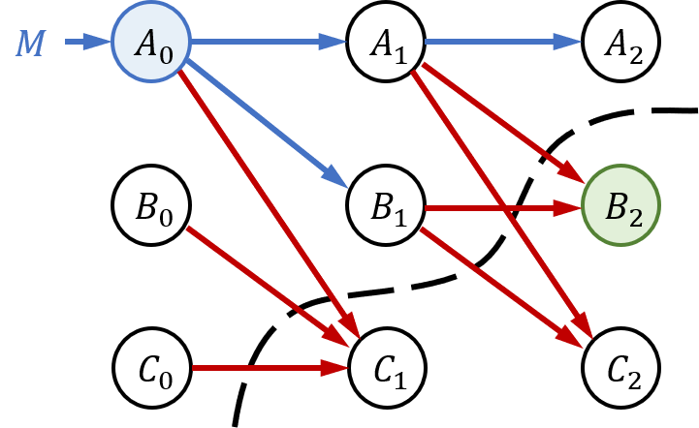
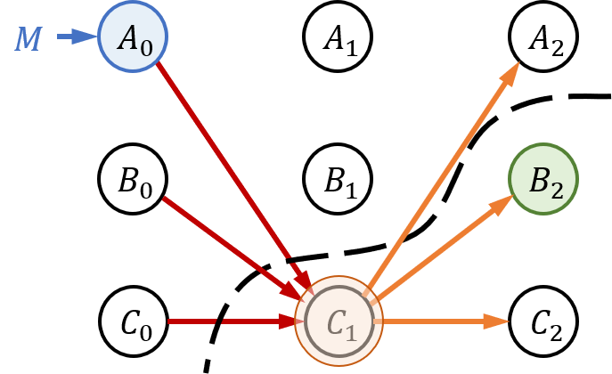
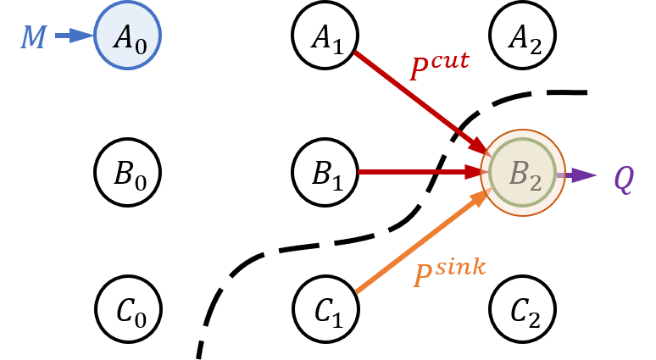
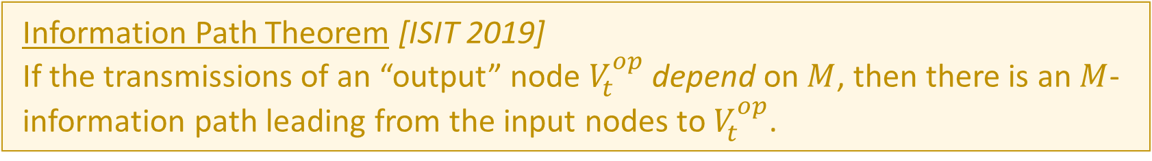
Info path theorem: Proof sketch
Information Path Theorem [ISIT 2019]
If the transmissions of an “output” node $V_{t}^{op}$ depend on $M$, then there is an $M$-information path leading from the input nodes to $V_{t}^{op}$.
$∃$ no $M$-information path from $V_{0}^{ip}$to $V_{t}^{op}$ $⇒$ Transmissions of $V_{t}^{op}$ cannot depend on $M$
Proof is based on cut-sets: Need to consider cuts across time Proof proceeds via induction over time
$$I\left(M;X\left(Q\right)\right)≤I\left(M;X\left(P^{sink}\right), X\left(P^{cut}\right)\right)=I\left(M;X\left(P^{sink}\right)\right)+I\left(M;X\left(P^{cut}\right)| X\left(P^{sink}\right)\right)=0$$

Slide 12
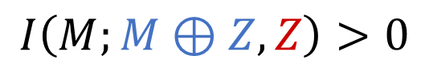
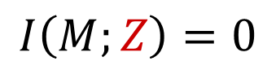
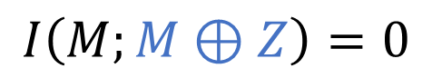
Partial Information Decomposition (PID)
$$I\left(M:\left(X,Y\right)\right)=UI\left(M:X∖Y\right)+UI\left(M:Y∖X\right)+RI\left(M:X;Y\right)+SI(M:X;Y)$$
Unique to X
Unique to Y
Redundant
Synergistic
Synergy:
$$I\left(M;M⊕Z\right)=0$$
$$I\left(M;Z\right)=0$$
$$I\left(M;M⊕Z, Z\right)>0$$
Synergy in Neuroscience: Schneidman et al. (2003); Gat & Tishby (1999); Venkatesh & Grover (Cosyne 2020); …
Partial Information Decomposition: Williams and Beer (2010); Bertschinger et al. (2014); Lizier et al. (2018); …

Slide 13
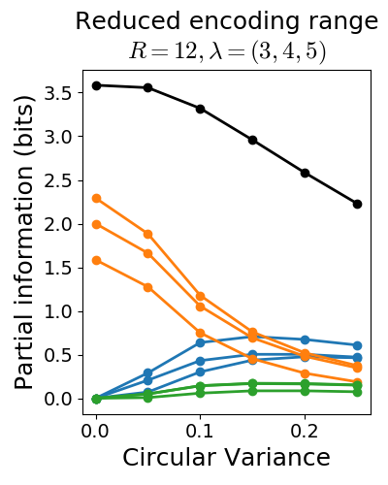
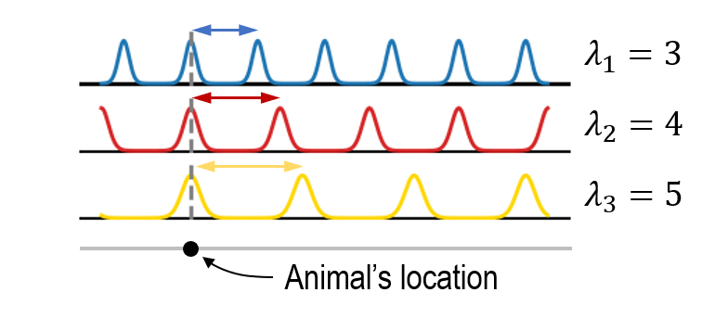
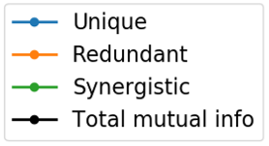
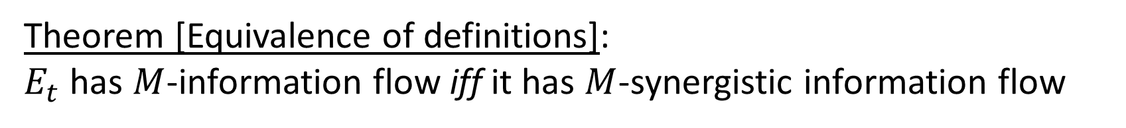
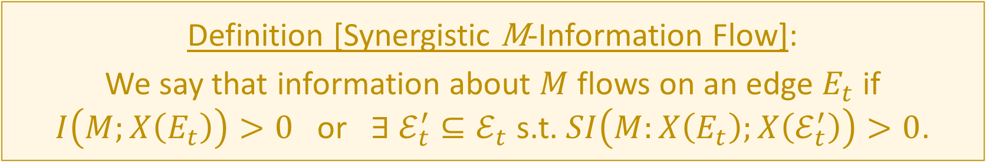
Partial Information Decomposition (PID)
$$I\left(M:\left(X,Y\right)\right)=UI\left(M:X∖Y\right)+UI\left(M:Y∖X\right)+RI\left(M:X;Y\right)+SI(M:X;Y)$$
PID can help provide fine-grained inferences on information flow
(Venkatesh & Grover, Cosyne 2020)
Unique to X
Unique to Y
Redundant
Synergistic
Definition [Synergistic M-Information Flow]:
We say that information about $M$ flows on an edge $E_{t}$ if
$I\left(M;X\left(E_{t}\right)\right)>0$ or $∃ ℰ_{t}^{′}⊆ℰ_{t}$ s.t. $SI\left(M:X\left(E_{t}\right);X\left(ℰ_{t}^{′}\right)\right)>0$.
The info path theorem is the first formal connection between information flow and PID
Theorem [Equivalence of definitions]:
$E_{t}$ has $M$-information flow iff it has $M$-synergistic information flow
Synergy in Neuroscience: Schneidman et al. (2003); Gat & Tishby (1999); Venkatesh & Grover (Cosyne 2020); …
Partial Information Decomposition: Williams and Beer (2010); Bertschinger et al. (2014); Lizier et al. (2018); …

Slide 14


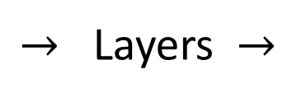

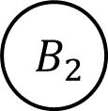













Connections to AI: Fairness and Explainability
“I thought that looked like a neural network!”
$$t=0$$
$→$ Layers $→$
Information flow $$≡$$ Tracking how bias propagates $$≡$$ Introspect and identify bad program components
$$t=1$$
$$t=2$$
$$M$$
$$A_{0}$$
$$X(E_{0})$$
$$A_{1}$$
$$X(E_{1})$$
$$A_{2}$$
Protected attribute (e.g. race, gender)
$$B_{0}$$
$$B_{1}$$
$$B_{2}$$
(New measures of discrimination: Dutta, Venkatesh et al., AAAI 2020)
$$C_{0}$$
$$C_{1}$$
$$C_{2}$$
$$f(M)$$
Classifier output

Slide 15











Summary
Information Flow & PID
Neuroengineering: Fundamental Limits and Algorithms
(Venkatesh, Dutta and Grover, IEEE Trans IT sub.; ISIT 2019; ISIT 2020 sub.)
AI and Fairness
(Theory: Grover and Venkatesh, Proc. IEEE 2016)
(Fundamental limits: Venkatesh and Grover, ISIT 2017)
(Dutta, Venkatesh, Mardziel, Datta and Grover, AAAI 2020; ISIT 2020 submitted)
(Experimental validation: Robinson, Venkatesh et al., Sci. Rep. 2017)
(Clinical use case: Chamanzar, …, Venkatesh et al., IEEE Trans. BME 2018)

Slide 16


How do we define information flow?
1
2
Candidate definition 2: Condition on one edge
3
Information flows on an edge $E_{t}$ if $I\left(M;X\left(E_{t}\right)\right)>0$, or if $I\left(M;X\left(E_{t}\right) | X\left(E_{t}^{′}\right)\right)>0$ for some $E_{t}^{′}$.
✓
$$I\left(M; M⊕Z | Z\right)>0$$

Slide 17





















Implications for Neuroengineering
Can we measure only nodes? (Assume nodes multicast)
$$A_{1}$$
$$A_{2}$$
$$A_{3}$$
Can’t differentiate these two cases
$$M$$
$$M$$
Interventions will produce different effects!
$$M$$
$$B_{1}$$
$$B_{2}$$
$$B_{3}$$
$$M$$
$⇒$ We need to measure edges!
$$M$$
$$A_{1}$$
$$A_{2}$$
$$A_{3}$$
$$M$$
(Patolsky et al., Science 2006)
Theory can give rise to new insights and problems in neuroengineering
$$M$$
$$B_{1}$$
$$B_{2}$$
$$B_{3}$$
$$M$$

Slide 18



Partial Information Decomposition (PID)
Synergy:
$$I\left(M;M⊕Z\right)=0$$
$$I\left(M;Z\right)=0$$
$$I\left(M;M⊕Z, Z\right)>0$$
Synergy in Neuroscience: Schneidman et al. (2003); Timme & Lapish (2018); Venkatesh & Grover (Cosyne 2020); …
Partial Information Decomposition: Williams and Beer (2010); Bertschinger et al. (2014); Lizier et al. (2018); …

Slide 19
Partial Information Decomposition (PID)
$$I\left(M:\left(X,Y\right)\right)=UI\left(M:X∖Y\right)+UI\left(M:Y∖X\right)+RI\left(M:X;Y\right)+SI(M:X;Y)$$
PID can help provide fine-grained inferences on information flow
(Venkatesh & Grover, Cosyne 2020)
Unique to X
Unique to Y
Redundant
Synergistic
Definition [Synergistic M-Information Flow]:
We say that information about $M$ flows on an edge $E_{t}$ if
$I\left(M;X\left(E_{t}\right)\right)>0$ or $∃ ℰ_{t}^{′}⊆ℰ_{t}$ s.t. $SI\left(M:X\left(E_{t}\right);X\left(ℰ_{t}^{′}\right)\right)>0$.
The info path theorem is the first formal connection between information flow and PID
Theorem [Equivalence of definitions]:
$E_{t}$ has $M$-information flow iff it has $M$-synergistic information flow
Synergy in Neuroscience: Schneidman et al. (2003); Timme & Lapish (2018); Venkatesh & Grover (Cosyne 2020); …
Partial Information Decomposition: Williams and Beer (2010); Bertschinger et al. (2014); Lizier et al. (2018); …

Slide 20




Partial Information Decomposition (PID)
$$I\left(M:\left(X,Y\right)\right)=UI\left(M:X∖Y\right)+UI\left(M:Y∖X\right)+RI\left(M:X;Y\right)+SI(M:X;Y)$$
Unique to X
Unique to Y
Redundant
Synergistic
$$≥0$$
$$≥0$$
$$≥0$$
$$≥0$$
Our framework is definition-agnostic
$$I\left(M:X\right)=UI\left(M:X∖Y\right)+RI\left(M:X;Y\right)$$
$$I\left(M:X | Y\right)=UI\left(M:X∖Y\right)+SI\left(M:X;Y\right)$$
Synergy in Neuroscience: Schneidman et al. (2003); Sreenivasan & Fiete (2011); Timme & Lapish (2018); …
Partial Information Decomposition: Bertschinger et al. (2014); Wibral, Lizier & Priesemann (2015); …

Slide 21
In terms of Synergistic Information
Conjecture:
Any definition of information flow that allows you to track information paths must account for synergistic information.

Slide 22






Prior Approaches to Information Flow
Functional Connectivity
Granger Causality (Granger, 1969; Bressler & Seth, 2011)
Transfer Entropy (Schreiber, 2000)
Directed Information (Massey, 1990; Quinn et al., 2011)
How do you get Information Flow from Granger Causality?
$$GC_{A→B}$$
A
B
$$GC_{B→A}$$
$$?$$
$$GC_{A→B}>GC_{B→A}$$

Slide 23






A Counterexample to Granger Causality
Direction of greater Granger causal influence = Direction of info flow?
A counterexample based on the Schalkwijk & Kailath feedback scheme (1966)
Message
Error in estimate
$$Z_{i} \sim N(0, σ^{2})$$
A
B
$$X_{i}$$
$$Y_{i}$$
$$M$$
$$M$$
A
+
B
Greater GC-influence
$${\hat{M}}_{i}$$
Best estimate
“Is the direction of greater Granger causal influence the same as the direction of information flow?” (Venkatesh & Grover, Allerton 2015; SfN 2015)

Slide 24
Why does Granger Causality fail?
Direction of greater GC-influence = Direction of info flow?
No!
Fundamental difficulty
GC influence is trying to be an estimator for information flow
But information flow is not formally defined
Philosophy
Let’s define information flow first, then estimate it
Use counterexamples to arrive at a definition for information flow

Slide 25
Granger Causality and Information Flow
Functional Connectivity
Granger Causality (Granger, 1969; Bressler & Seth, 2011)
Transfer Entropy (Schreiber, 2000)
Directed Information (Massey, 1990; Quinn et al., 2011)
How do you get Information Flow from Granger Causality?
$$GC_{A→B}$$
A
B
$$GC_{B→A}$$
$$?$$
$$GC_{A→B}>GC_{B→A}$$

Slide 26










Granger Causality and Information Flow
Direction of greater Granger causal influence = Direction of info flow?
A counterexample based on the Schalkwijk & Kailath feedback scheme (1966)
Error in estimate
$$Z_{i} \sim N(0, σ^{2})$$
$$X_{i}=\sum_{j=1}^{p}{α_{j}X_{i−j}}+c+ε_{i}$$
$$X_{i}$$
$$Y_{i}$$
$$M$$
A
+
B
$$X_{i}=\sum_{j=1}^{p}{{\tilde{α}}_{j}X_{i−j}}+\sum_{j=1}^{q}{{\tilde{β}}_{j}{\hat{M}}_{i−j}}+\tilde{c}+{\tilde{ε}}_{i}$$
$${\hat{M}}_{i}$$
Best estimate
$$GC_{B→A}=\frac{Var\left(ε\right)}{Var\left(\tilde{ε}\right)}$$
$$X_{i}=M−{\hat{M}}_{i−1}$$
$→∞$ !!
“Is the direction of greater Granger causal influence the same as the direction of information flow?” (Venkatesh & Grover, Allerton 2015; SfN 2015)

Slide 27




Resolving the Granger causality counterexample
$M$-Derived Information:
$M$—$X\left(P_{t^{′}}\right)$—$X(Q_{t})$
All edges have M-information flow!
Are Bob’s transmissions $M$-derived from Alice’s, or vice versa?

Slide 28


Resolving the Granger causality counterexample
$M$-Derived Information:
$M$—$X\left(P_{t^{′}}\right)$—$X(Q_{t})$
✓
✗
Bob’s transmissions are M-derived from Alice’s, but not vice versa!
$M$—$[M+Z, M−{\hat{M}}_{1}+Z_{2}]$—${\hat{M}}_{2}$
$M$—$[{\hat{M}}_{1}, { \hat{M}}_{2}]$—$M−{\hat{M}}_{2}+Z_{3}$

Slide 29

Summary
Need a theoretical framework for information flow
Interpreting GC can yield incorrect directions of info flow
Need to separate definition from estimation
New definition: $M$-Information Flow
Conditioning on some subset of edges: incorporating synergistic info
Directly associated with the message of interest, $M$
Able to prove the info-path theorem
Other benefits
Can obtain inferences that existing tools cannot:
Information flow in feedback networks
Tracking multiple messages
Detecting hidden nodes
“Information Flow in Computational Systems” arXiv:1902.02292 [cs.IT] (under review)

Slide 30


Remarks on the Info Flow Definition
An edge $E_{t}$ has $M$-info flow if $∃ ℰ_{t}^{′}⊆ℰ_{t}$ s.t. $I\left(M;X\left(E_{t}\right) | X(ℰ_{t}^{′})\right)>0$.
An edge $E_{t}$ has no $M$-info flow if $∀ ℰ_{t}^{′}⊆ℰ_{t}$, $I\left(M;X\left(E_{t}\right) | X(ℰ_{t}^{′})\right)=0$.
Condition on the empty set:
No $M$-info flow $⇒$ $I\left(M;X\left(E_{t}\right)\right)=0$ $⇒$ No dependence on $M$

Slide 31



Remarks on the Info Flow Definition
An edge $E_{t}$ has $M$-info flow if $∃ ℰ_{t}^{′}⊆ℰ_{t}$ s.t. $I\left(M;X\left(E_{t}\right) | X(ℰ_{t}^{′})\right)>0$.
$M$-info flows out of a node $⇒$ $M$-info flows into the node
$$I\left(M; M⊕Z | Z\right)>0$$
$$I\left(M; Z | M⊕Z\right)>0$$

Slide 32








The Existence of Information Paths
Definition [$M$-Information Path]
A path, every edge of which has $M$-information flow
Information Path Theorem
If the transmissions of an “output” node $V_{t}^{op}$ depend on $M$, then there is an $M$-information path leading from the input nodes to $V_{t}^{op}$.
✗
$$V_{0}^{ip}$$
$$M$$
$$A_{0}$$
$$X(E_{0})$$
$$A_{1}$$
$$X(E_{1})$$
$$A_{2}$$
Info flow out $⇒$ Info flow in
$$V_{t}^{op}$$
$$B_{0}$$
$$B_{1}$$
$$B_{2}$$
$$⊥$$
$$⊥$$
$$f\left(M\right) M$$

Slide 33


Proving the Info Path theorem
Transmissions of $V_{t}^{op}$ depend on $M$ $⇒∃$ an $M$-information path from $V_{0}^{ip}$to $V_{t}^{op}$
We’ll prove the contrapositive:
$∃$ no $M$-information path from $V_{0}^{ip}$to $V_{t}^{op}$ $⇒$ Transmissions of $V_{t}^{op}$ cannot depend on $M$

Slide 34


















A Proof Sketch through Pictures
$∃$ no $M$-information path from $V_{0}^{ip}$to $V_{t}^{op}$
$$V_{0}^{ip}$$
$$M$$
$$A_{0}$$
$$A_{1}$$
$$A_{2}$$
Zero-$M$-information Cut
Red edges have zero $M$-info flow
$$V_{t}^{op}$$
$$B_{0}$$
$$B_{1}$$
$$B_{2}$$
$$⊥$$
$$⊥$$
$Q M$ (Claim)
$$C_{0}$$
$$C_{1}$$
$$C_{2}$$
$⇒ ∃$ a zero $M$-information cut separating $V_{0}^{ip}$and $V_{t}^{op}$

Slide 35














A Proof Sketch through Pictures
$$M$$
$$A_{0}$$
$$A_{1}$$
$$A_{2}$$
Zero-$M$-information Cut
Red edges have zero $M$-info flow
$$B_{0}$$
$$B_{1}$$
$$B_{2}$$
Orange edges are independent of $M$
$$C_{0}$$
$$C_{1}$$
$$C_{2}$$
No $M$-info flow $⇒$ No incoming dependence on $M$
$⇒$ No outgoing dependence on $M$ (by DPI)

Slide 36








A Proof Sketch through Pictures
$$M$$
$$A_{0}$$
$$A_{1}$$
$$A_{2}$$
Zero-$M$-information Cut
$$P^{cut}$$
Red edges have zero $M$-info flow
$$B_{0}$$
$$B_{1}$$
$$B_{2}$$
$$Q$$
$$=f\left(M\right)$$
Orange edges are independent of $M$
$$P^{sink}$$
$$C_{0}$$
$$C_{1}$$
$$C_{2}$$
$$I\left(M;X\left(Q\right)\right)$$
$≤I\left(M;X\left(P^{sink}\right), X\left(P^{cut}\right)\right)$
(By DPI)
$$=I\left(M;X\left(P^{sink}\right)\right)+I\left(M;X\left(P^{cut}\right)| X\left(P^{sink}\right)\right)$$
$$=0$$

Slide 37


A Proof Sketch through Pictures
$$M$$
$$A_{0}$$
$$A_{1}$$
$$A_{2}$$
Zero-$M$-information Cut
$$P^{cut}$$
Red edges have zero $M$-info flow
$$B_{0}$$
$$B_{1}$$
$$B_{2}$$
$$Q$$
$$=f\left(M\right)$$
Orange edges are independent of $M$
$$P^{sink}$$
$$C_{0}$$
$$C_{1}$$
$$C_{2}$$
Transmissions of $V_{t}^{op}$ depend on $M$ $⇒∃$ an $M$-information path from $V_{0}^{ip}$to $V_{t}^{op}$
$∃$ no $M$-information path from $V_{0}^{ip}$to $V_{t}^{op}$ $⇒$ Transmissions of $V_{t}^{op}$ cannot depend on $M$

Slide 38

Multiple messages
What if we have two independent messages?
E.g., shape and colour
(Ahlswede et al., 2000)
(Almeida et al., 2013)
We can track information flows of multiple, independent messages/stimuli

Slide 39














Hidden Nodes
Hidden
$$H_{1}$$
$$Z$$
$$Z$$
$$M$$
$$A_{0}$$
$$A_{1}$$
$$A_{2}$$
$$M$$
$$M⊕Z$$
$$M⊕Z$$
Observed
Markov properties that should (ordinarily) never be violated:
$$X(𝒫_{t})$$
$$V_{t}$$
$$X(𝒬_{t})$$
$$M−X\left(𝒫_{t}\right)−X(𝒬_{t})$$
…
…
Some hidden nodes break Local Markov Properties

